Slide 1
Your Topic
1. 含氮GO的水熱合成: 用urea調控pH
2. MB在可見光催化
Your Name
實驗紀錄簿編號
報告時間 (i.e. 5. 31. 2023)
From 5. 24. 2023 to 5. 30. 2023

Slide 2
Last Week
What are the tasks to do?

Slide 3
Goal of this week
What’s the goal or motivation to do in this week?

Slide 4
合成 (Preparation)
Sample (Name) | Code (Lab notebook) | Method | Description | Characterization | Others

Slide 5
Preparation (合成)
鑑定結果
重點說明
此實驗哪裡不同?
為何作這個實驗
Sample (Name) | Code (Lab notebook) | Method | Description | Characterization | Others
Cobalt manganese oxide (CMO) | CCM-35 | hydrothermal | Low cobalt content (vs. CCM-36) | XRD, SEM, EDS | P. 35
CMO-100 | CCM-36 | hydrothermal | High cobalt content (vs. CCM-35) 再現性測試 | XRD | P. 36 in your lab note
Nitrogen-doped G.O. | KGG-89 | Hummers | 我使用新的石墨粉 (vs KGG-87) | Not yet | 好像失敗了，重作一次再比較 (KGG-90)
單層石墨烯 | LGM-56 | CVD | 新的銅片，時間由原來 20min 縮短到 5min (vs LGM-20) | Raman, 光學顯微鏡相片 (好像是多層) | 時間縮短破洞好像變多
鑑定結果列在後續投影片

Slide 6
Procedure / Methodology

Slide 7
Results of Samples
Your Results Here
Description
What are we seeing?
Description
Comparison?
Description
Where are these results?
Description
Where are these results?

Slide 8
Results (SEM) of Samples (CMO-100)
Description
After GO hybridization
Description
Before GO hybridization
Description
Path: chc/結果/SEM/gcmo-20-2
Description
Path: chc/結果/SEM/cmo-100C-12
Exp. Code
CCM-36
Exp. Code
CCM-10
File Path of figures or data

Slide 9
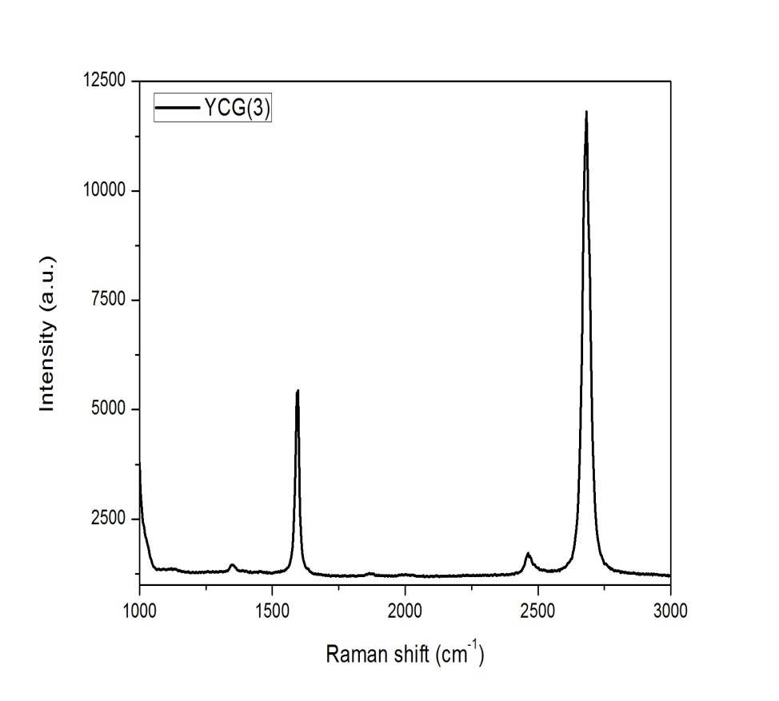
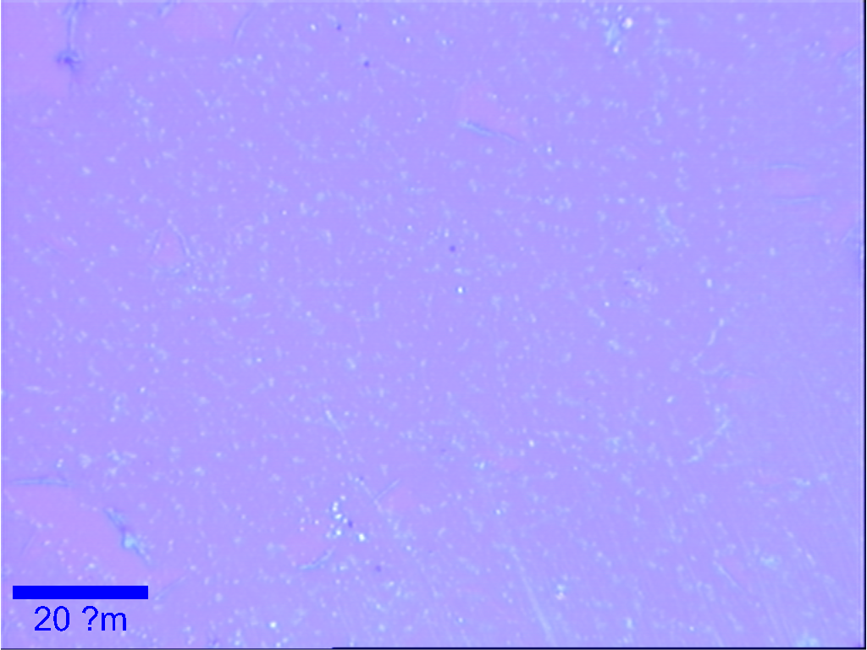
單層石墨烯 (新銅片) of YCG-3
光學顯微鏡圖 (OM)
新銅片作的石墨烯
表面不乾淨有大量破洞
光學顯微鏡圖 (OM of something; if more than one)
新銅片作的石墨烯
表面不乾淨有大量破洞
Patch: YCG/結果/Raman/OM-5
Path: YCG/結果/Raman/spec/YCG-3-5
YCG-3
File Path of figures or data

Slide 10
What I Learn
This page is for undergraduate students.

Slide 11
Conclusion
What is the meaning of your data?
What is the critical message for your next move?
What do we learn from your data?

Slide 12
Next
What are you going to do next?

Slide 13
Paper
No | Title | Journal | Year | Remark
1 | Activation Energy Assessing Potential-Dependent Activities and Site Reconstruction for Oxygen Evolution | ACS Energy Letters | 2022 | Done
2
3

