Slide 1
Choosing Keywords for Publication

Slide 2
Source
https://www.wiley.com/network/researchers/preparing-your-article/how-to-choose-effective-keywords-for-your-article
https://authorservices.wiley.com/author-resources/Journal-Authors/Prepare/writing-for-seo.html
Findability, Keywords, and the Content in the Journal of Chemical Education, J. Chem. Educ. 2022, 99, 1147−1148

Slide 3
Different opinion
Best practice for SEO (Search Engine Optimization) includes mentioning the keywords every 100 to 200 words -- your titles, subheadings, and at the beginning, and end of your article. (Wiley)
Provide significant keywords to aid the reader in literature retrieval. Please consider the use of words different from those in the title to expand the discoverability of the article. (ACS, 2022)

Slide 4
Key points (Wiley)
Title Creation → A title catches the attention of readers, but it also introduces your main point.
Word Clusters or Word Clouds
Abstract → Abstracts are usually just a few hundred words, so putting the keywords in two or three times makes sense.
Use Google Search Engine Result Pages → Search using a common phrase for your topic.

Slide 5
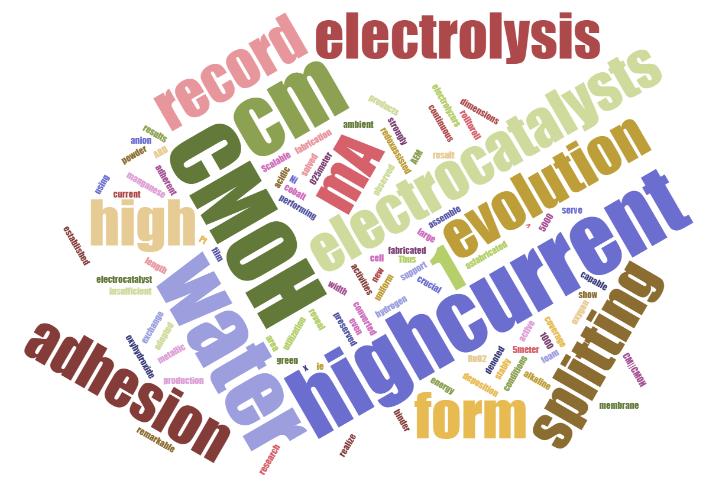
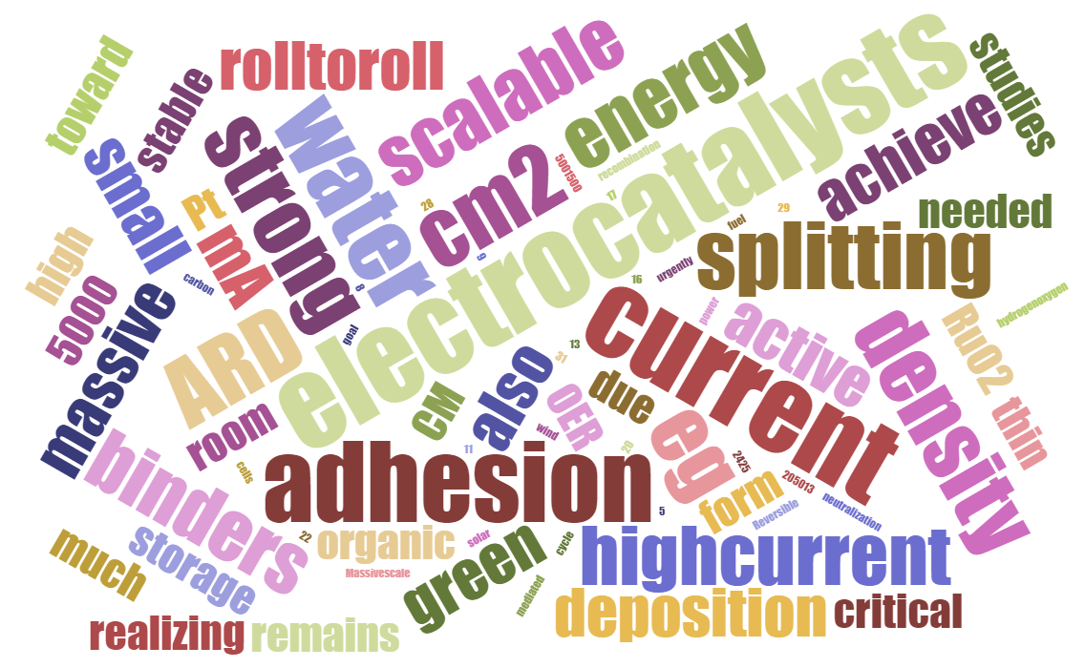
Key points (Wiley)
Word Clusters or Word Clouds
https://www.jasondavies.com/wordcloud/
Example from Roll to roll high-current
Introduction
Example from Roll to roll high-current Abstract

Slide 6
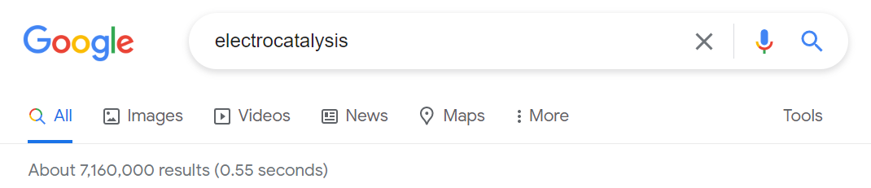
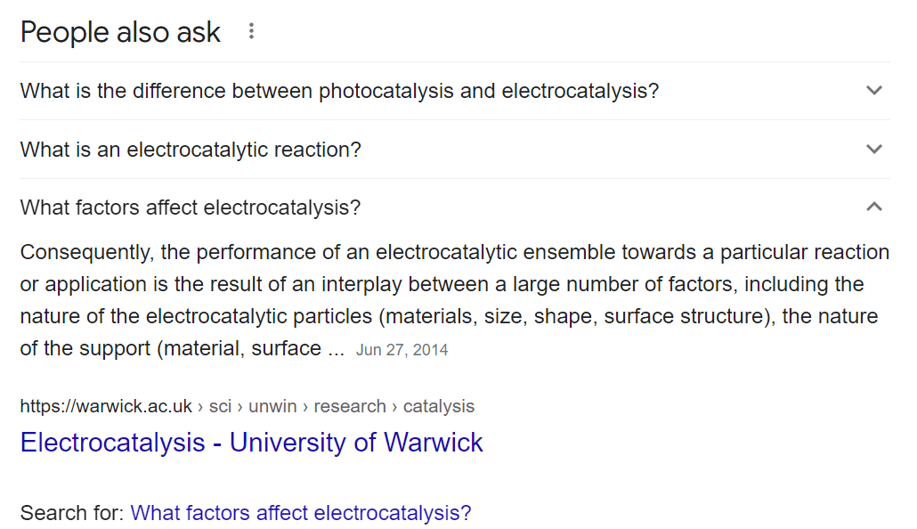
Key points (Wiley)
Use Google Search Engine Result Pages → Search using a common phrase for your topic.

Slide 7
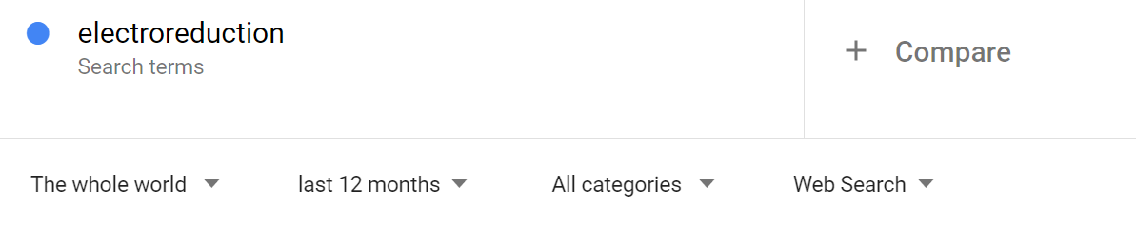
Key points (Wiley)
Find specific keywords on Google Trends and Google Adwords keyword tools
Remember that keywords are important for A&I services as well as SEO

Slide 8
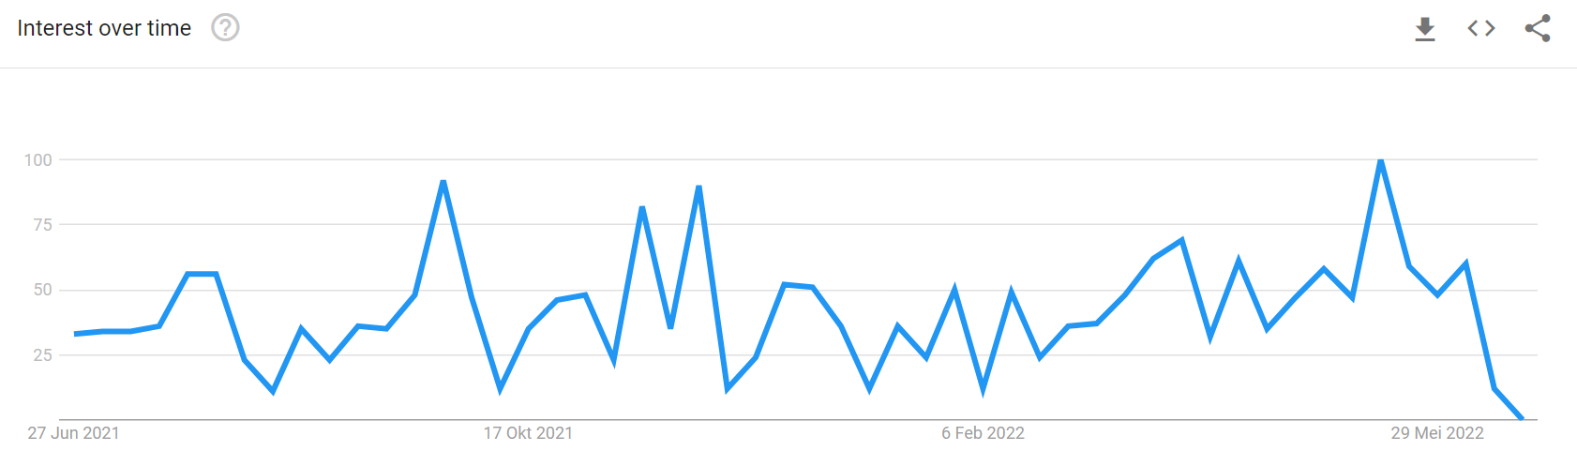
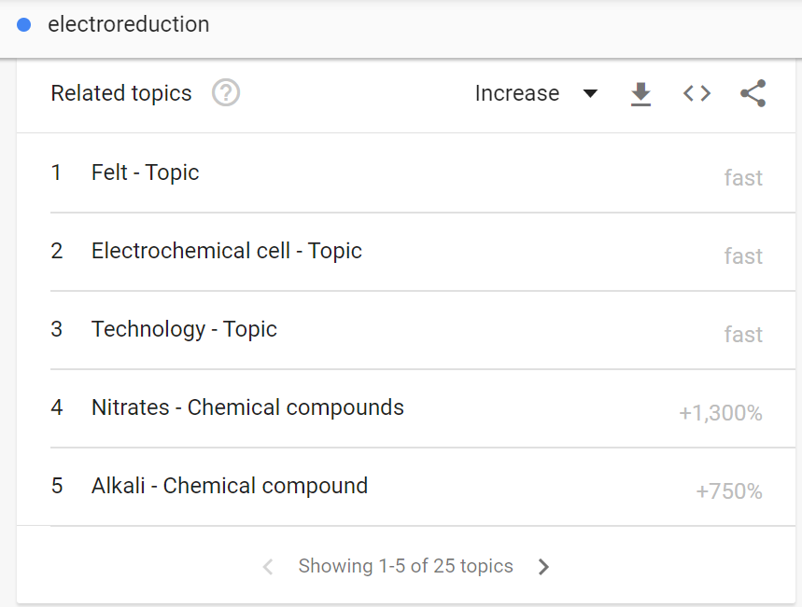
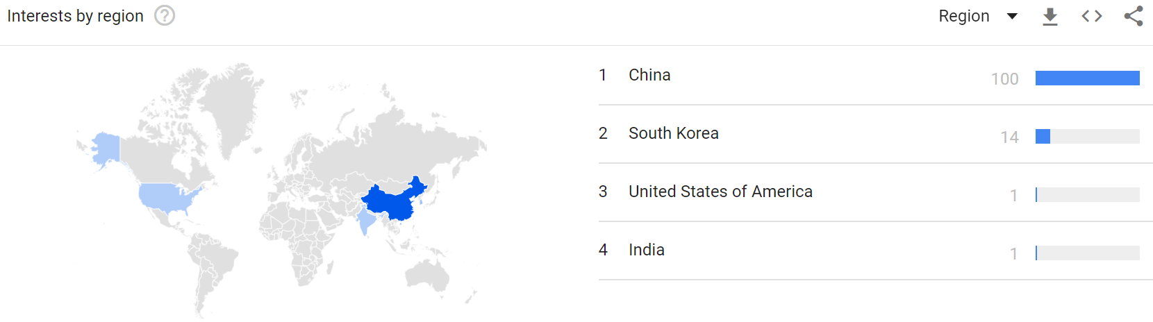

Slide 9
Additional (ACS, 2022)
By allowing authors to select diverse keywords that accurately describe their work, the Journal aims to enhance findability of the articles by interested readers. Readers and authors alike must consider the fact that concepts of interest might be described using many different words. The more expansive and diverse the vocabulary found in the metadata of an article is, the greater the likelihood is that it will be retrieved in a relevant search.
Another important consideration is the global scope of the Journal and the varying vocabulary that its readers might use to describe their work. For example, a manuscript that describes “laboratory exercises”, phrasing more common in North America, might garner wider global findability by including “laboratory practical” as part of the keyword list.

Slide 10
Additional
Search for the keywords that being used in highly cited paper in the fields.
Also can go with the paper publish from the popular/famous researcher group in the field.
Use more than single-word keywords.

Slide 11
Keyword Citation Reports via Web of Science
20200623

Slide 12
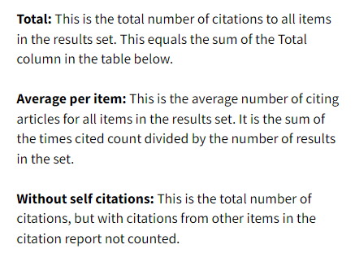
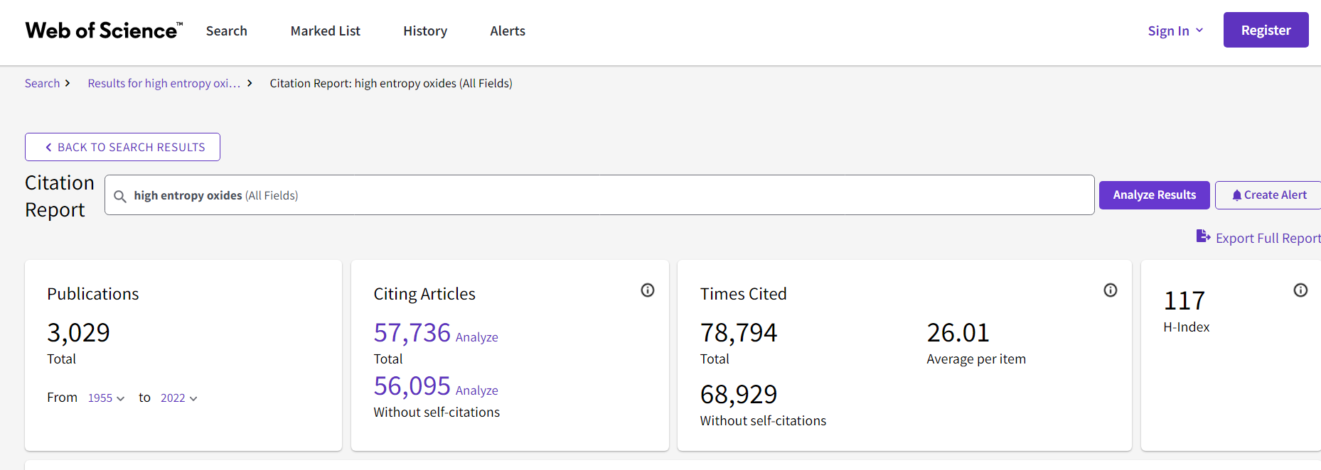
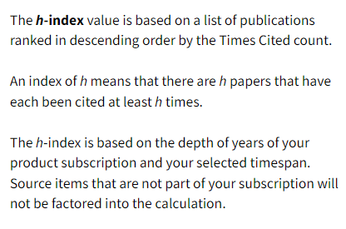
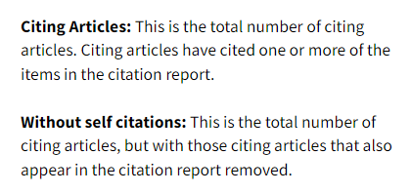
Notes:
Citation Reports are only available for keywords that have < 10,000 articles.

Slide 13
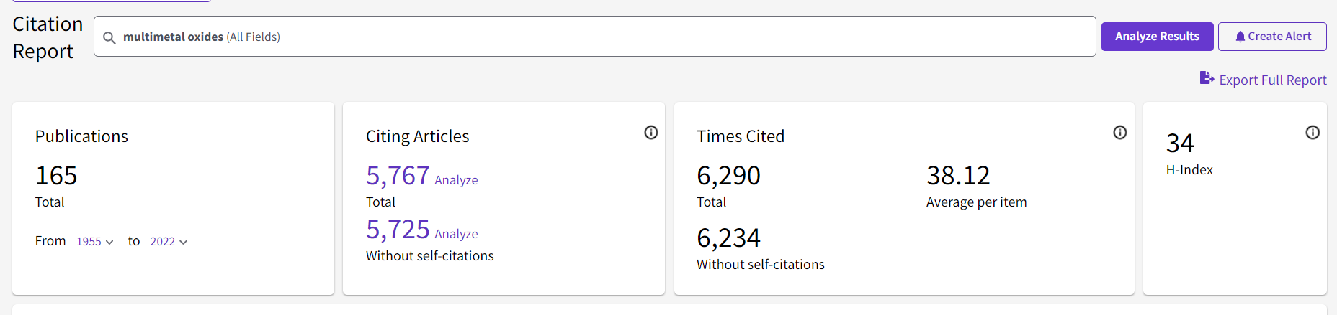
All-time Statistics
3.86% chanc

Slide 14
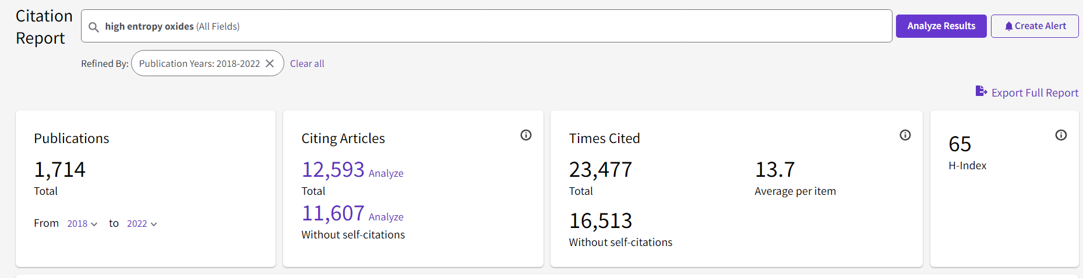
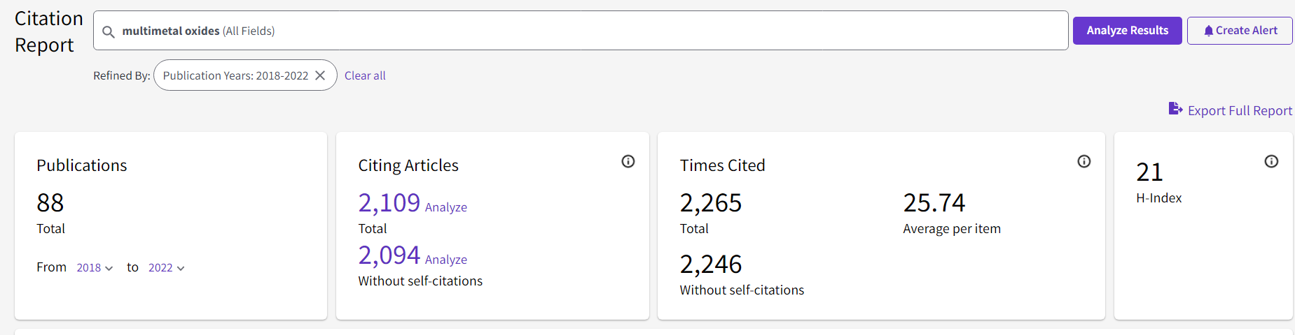
Five-year Statistics

Slide 15
Which is a better keyword?
Keyword | Number of Articles | Citing Articles (except self-citations) | Average Citations/ Article | h – index
Seawater splitting | 376 | 4,207 | 16.55 | 41
Saltwater splitting | 15 | 75 | 5.33 | 7
Seawater electrolysis | 291 | 2,904 | 16.35 | 34
Saltwater electrolysis | 6 | 25 | 4.17 | 3
Keyword | Number of Articles | Citing Articles (except self-citations) | Average Citations/ Article | h – index
Antibacterial coating | 5,781 | 39,263 | 12.22 | 80
Bactericidal coating | 728 | 6,841 | 11.88 | 41
Statistics from publications in the last 5 years (2018-2022)
(Source: Web of Science)

Slide 16
Which is a better keyword?
Keyword | Number of Articles | Citing Articles (except self-citations) | Average Citations/ Article | h – index
Antibacterial coating | 5,781 | 39,263 | 12.22 | 80
Bactericidal coating | 728 | 6,841 | 11.88 | 41
Statistics from publications in the last 5 years
(Source: Web of Science)

Slide 17

Joey Andrew Valinton
2022.06.20

Slide 18
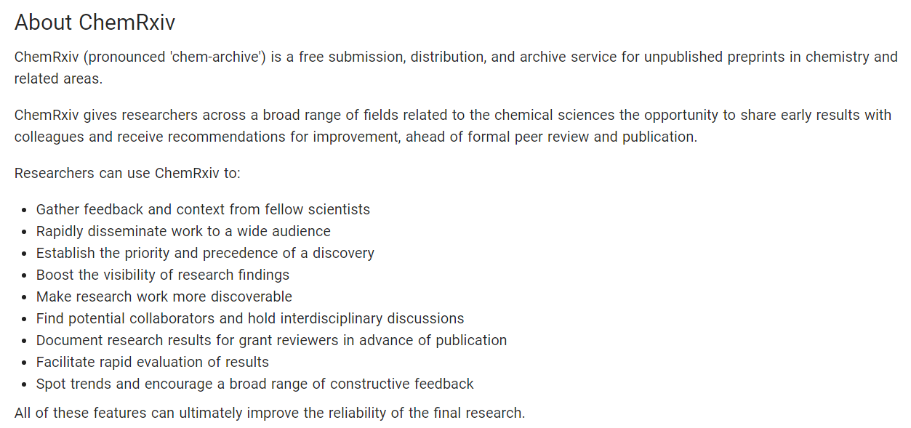
Uploading to a preprint server prior to publication can give unsolicited comments about the work for improvement on the topic.
You can also have it under Creative Commons License prior to direct transfer to a publication.

Slide 19
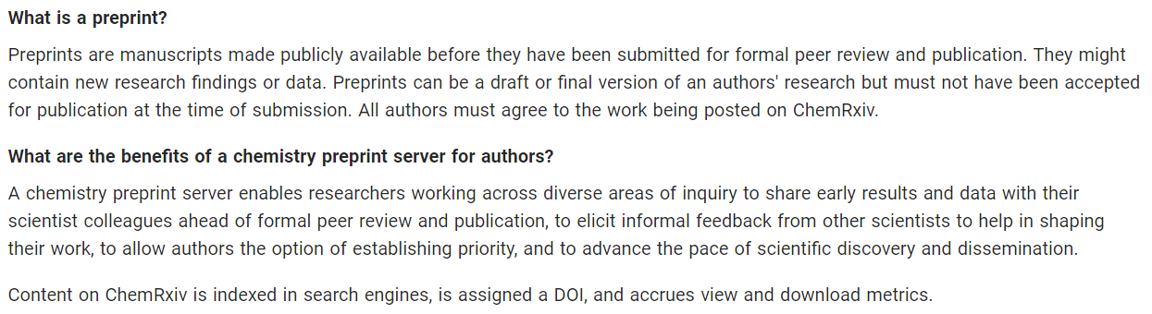
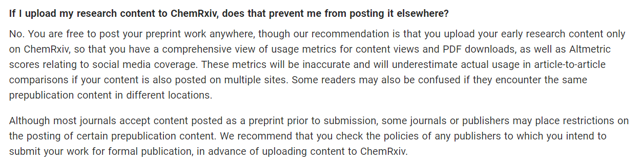

Slide 20
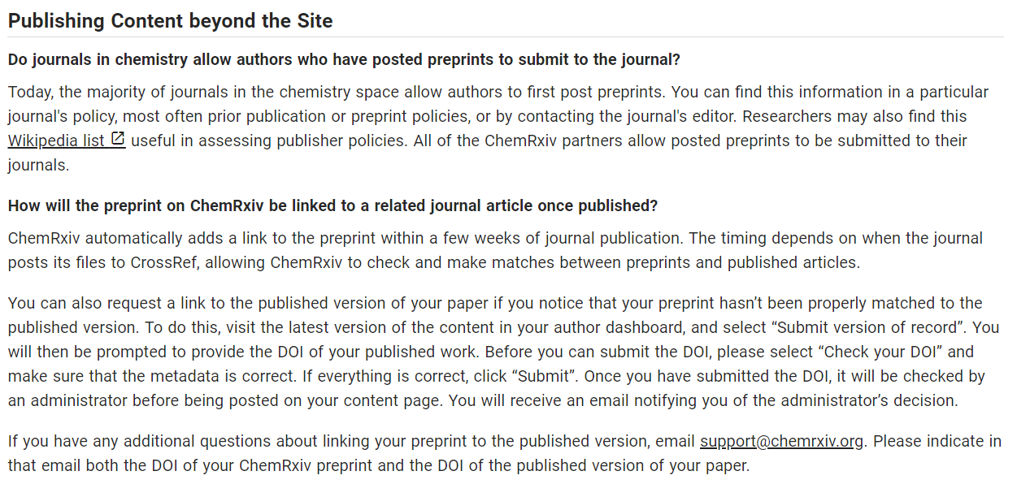

Slide 21
